Slide 1

Personalised product recommendation
Team MahaDevs

Slide 2
TEAM
MEMBERS
DETAILS
TEAM NAME | Team MahaDevs | Team MahaDevs | Team MahaDevs
INSTITUTE NAME | University School of Automation & Robotics (USAR), GGSIPU | University School of Automation & Robotics (USAR), GGSIPU | University School of Automation & Robotics (USAR), GGSIPU
TEAM MEMBERS | Leader (1) | Team Member(2) | Team Member(3)
NAME | Shubh Sardana | Aditya Singh | Ayush Gupta
BATCH | 2025 | 2025 | 2025

Slide 3



RECOMMENDING PRODUCTS BASED ON USER'S PAST PURCHASE HISTORY
1.Addressing Repetitive Purchases
2. Transaction Handling Assumptions
Why This Use Case?
Users often exhibit consistent fashion preferences, leading to repetitive purchases.
By leveraging past purchase history, we can cater to users' known preferences.
Assumptions Made:
Assumed that users may repeat transactions for the same items.
Considered that previous identical transactions might be removed from the dataset.
3. Solution Approach and Algorithm Choice
4. Validating Algorithm Performance
Concluded that forming associations between products was crucial for capturing user preferences.
Chose Apriori due to its simplicity and effectiveness in capturing frequent itemsets.
Conducted experiments to compare Apriori with other algorithms.
Evaluated performance metrics such as execution time and association accuracy.
Apriori demonstrated satisfactory results for our small-moderate-sized dataset.

Slide 4
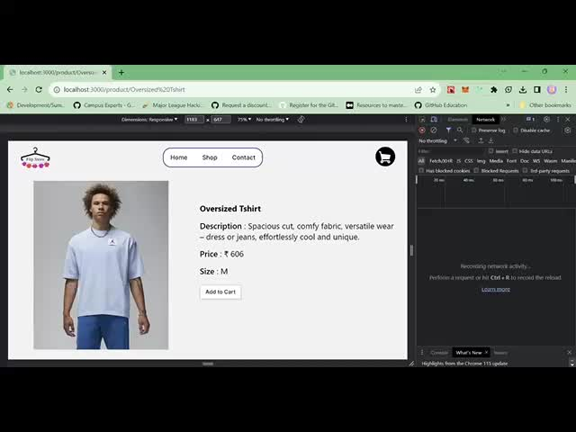

Slide 5
RECOMMENDING PRODUCTS BASED ON RATINGS FROM OTHER SIMILAR USERS
1. Leveraging User Similarity:
2. Similarity Identification Assumptions
Why This Use Case?
Users from the same region often share similar clothing and fashion patterns.
Recommending items based on similar users' preferences can lead to relevant suggestions.
Assumed that users with similar purchasing behaviors share common preferences.
Considered that users' ratings reflect their satisfaction with items.
3. Validation through Experimentation:
4. Solution Approach and Algorithm Choice
Conducted experiments to compare different collaborative filtering methods.
Evaluated accuracy and performance of recommendation predictions.
Memory-based Collaborative Filtering demonstrated superior results for our use case.
Utilizing Memory-based Collaborative Filtering:
Chose Memory-based Collaborative Filtering with nearest neighbors algorithm.
Nearest neighbors algorithm identifies users with similar trends using user rating data.

Slide 6
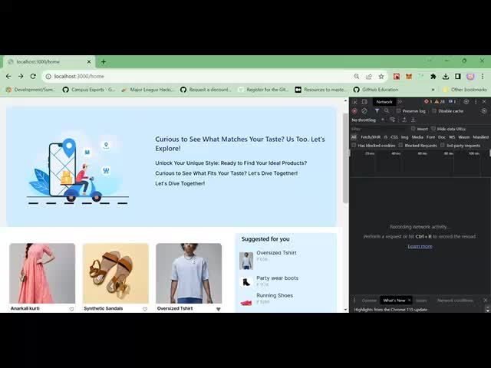

Slide 7
RECOMMENDING PRODUCTS TO NEW USERS BASED ON PRODUCT RATINGS
1. Engaging New Users with Ratings:
2. Assumptions for New Users:
Why This Use Case?
New users lack purchase history, requiring a different approach to engage them.
Recommending highly-rated products can capture their interest and trust.
Assumed that new users' preferences can be inferred from popular product ratings.
Considered that top-rated items have a higher likelihood of appealing to new users.
3. Validation through Experimentation:
4. Solution Approach and Algorithm Choice:
Conducted experiments comparing different product recommendation methods for new users.
Evaluated conversion rates and user engagement metrics.
Ratings-based Filtering with the hybrid strategy demonstrated improved engagement.
Ratings-based Filtering with Hybrid Strategy:
Adopted a hybrid strategy using both ratings count and average ratings.
Filtered products based on a combination of ratings and average ratings.

Slide 8
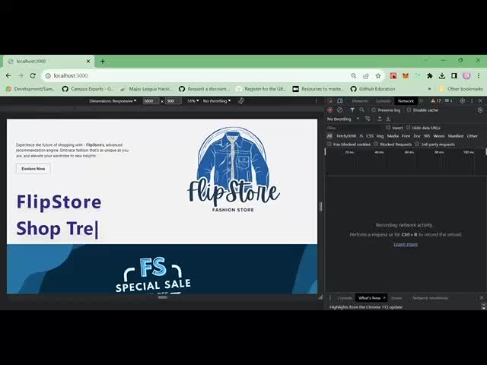

Slide 9
RECOMMENDING SIMILAR PRODUCTS BASED ON PRODUCT ADDED IN THE CART
1. Enriching Cart Experience:
2. Assumptions for Cart Recommendations
Why This Use Case?
Providing alternate choices for items in the user's cart enhances their shopping experience.
Diversifying options encourages users to explore more products.
Assumed that users seek variety and options while making a purchase.
Considered that products similar to those in the cart would be appealing alternatives.
4. Solution Approach:
3. Validation through Experimentation:
Item-based Collaborative Filtering Considered:
Initially explored Item-based Collaborative Filtering for finding item similarities.
However, observed lower accuracy in recommendations, leading to its discarding.
Cart-based Recommendation with Grouping:
Grouped similar items into categories for effective cart recommendations.
Recommended a random item from the corresponding category when an item was added to the cart.

Slide 10
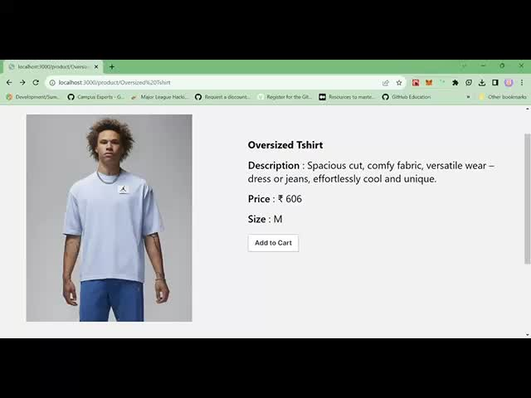

Slide 11

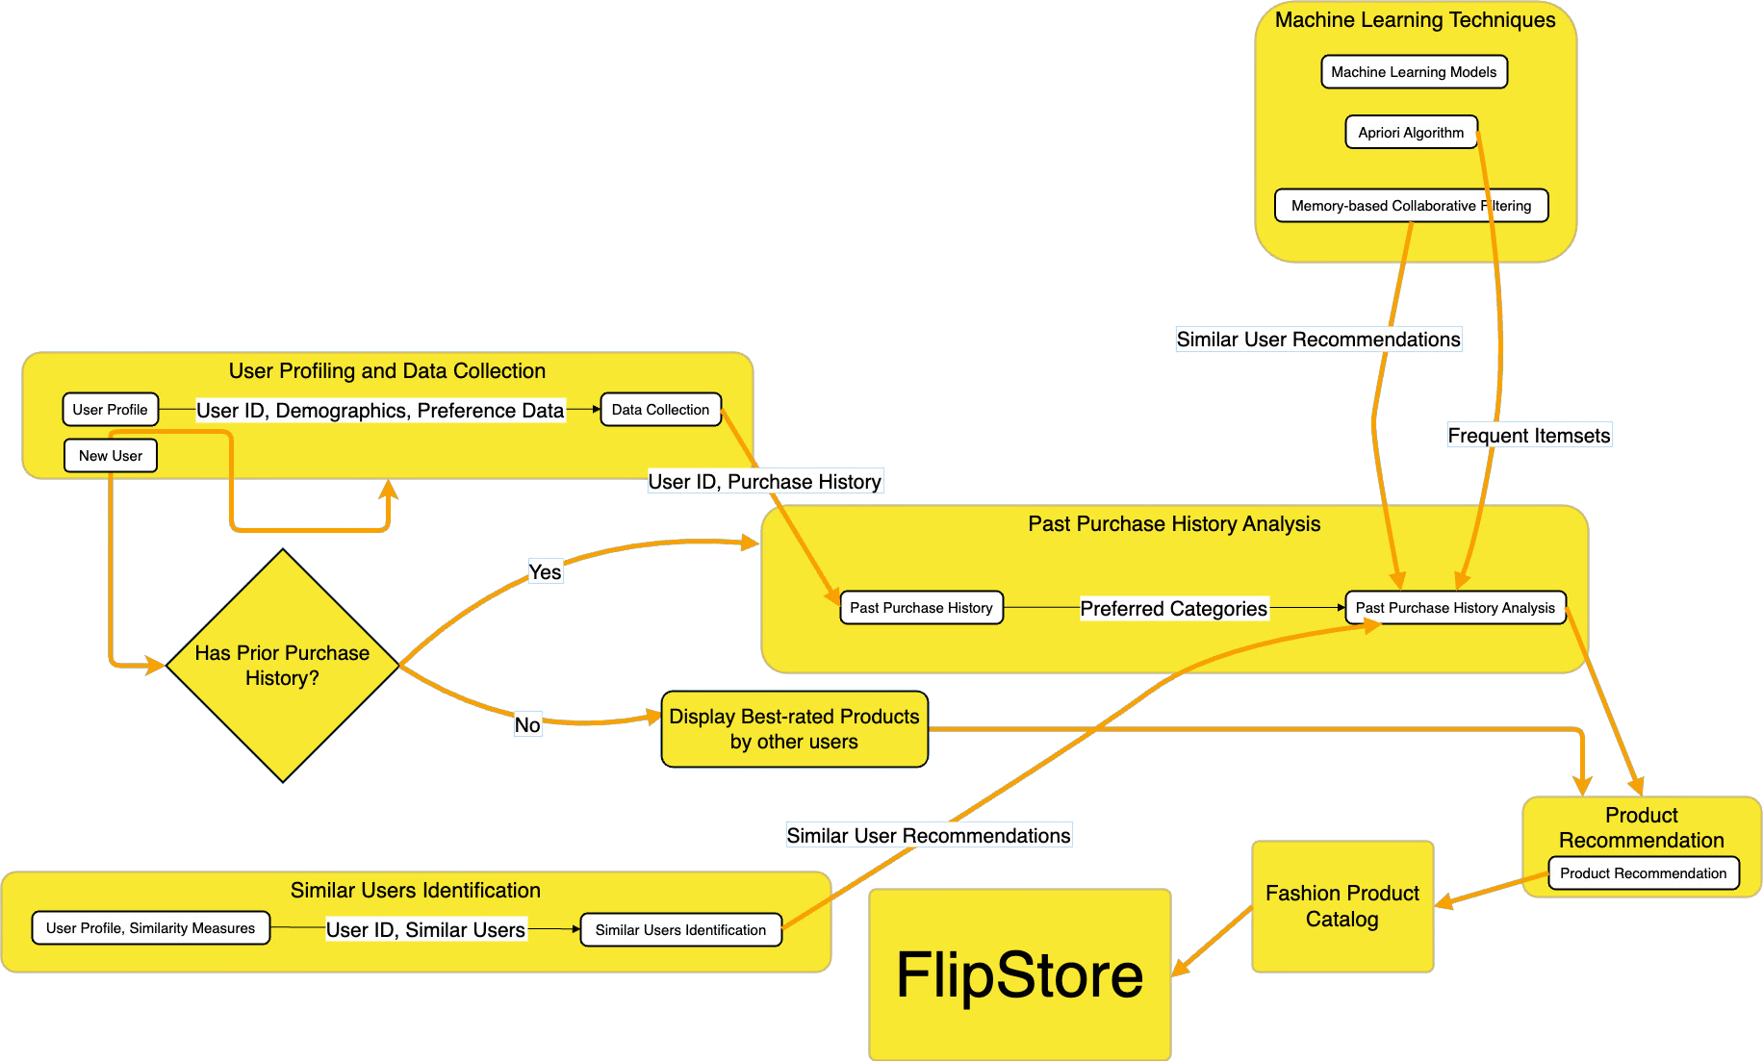
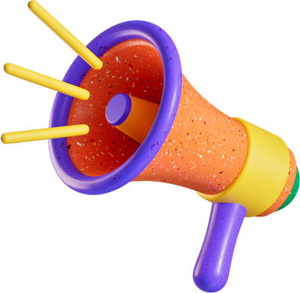
BLOCK
DIAGRAM

Slide 12

LIMITATIONS
1. Dynamic Trend Evolution Challenges:
2. Limited Contextual Understanding:
Past Purchase History Limitation:
The recommendations based on past purchase history might not fully grasp the nuanced context behind user preferences.
Factors such as changing seasons, special occasions, or one-time purchases might not be effectively captured.
Trend Identification Fluctuations:
Recommendations might not fully align with users' preferences during transitional trend periods.
3. Homogeneity of Regional Trends:
What makes us unique?
Ratings from Similar Users Constraint:
Relying solely on similar users from the same region might result in recommendations that lack diversity.
Users within the same region can have unique style preferences that extend beyond regional norms.
What truly sets FlipStore apart is its fusion of cutting-edge AI, user-centric design, ethical AI practices, and commitment to sustainability. This combination creates a shopping platform that not only adapts to individual preferences but also empowers users to embark on a fashion journey that resonates with their style and values.
WHELTON SCHOOL OF MARKETING | SESSION 1
Notes:
Key Takeaway:
While FlipStore's recommendation strategies are designed to enhance user experience, it's crucial to acknowledge these limitations. Addressing these constraints through ongoing research, data refinement, and algorithmic advancements will be integral to maintaining and improving our recommendation system's accuracy and relevance over time.

Slide 13




FUTURE SCOPE
Hyper-Personalized Recommendations:
Real-time Trend Analysis:
FlipGPT
Granular Personalization:
Advancing recommendation systems to incorporate granular details like fabric preferences, color choices, and design elements.
Providing hyper-personalized product suggestions that resonate deeply with individual users.
Real-time Data Processing:
Processing data in real-time from social media, fashion blogs, celebrity endorsements, and fashion shows.
Analyzing user-generated content and influencer activity to detect rising trends.
Empowering Users with GenAI:
Introducing FlipGPT, a Conversational Fashion Outfit Generator powered by GenAI.
Users can interact with an AI-powered assistant to receive instant, personalized fashion outfit suggestions based on preferences and occasions.

